Slide 1

WIPRO NGA Program – 25SUB4530_CP_JAVA
Capstone Project Presentation – 9th Feb & 10th Feb 2026
Project Title Here - E-commerce Order Management System
Presented by – Sri Santhosh & Sri Dikshitha
Team - 19
www.rpsconsulting.in

Slide 2
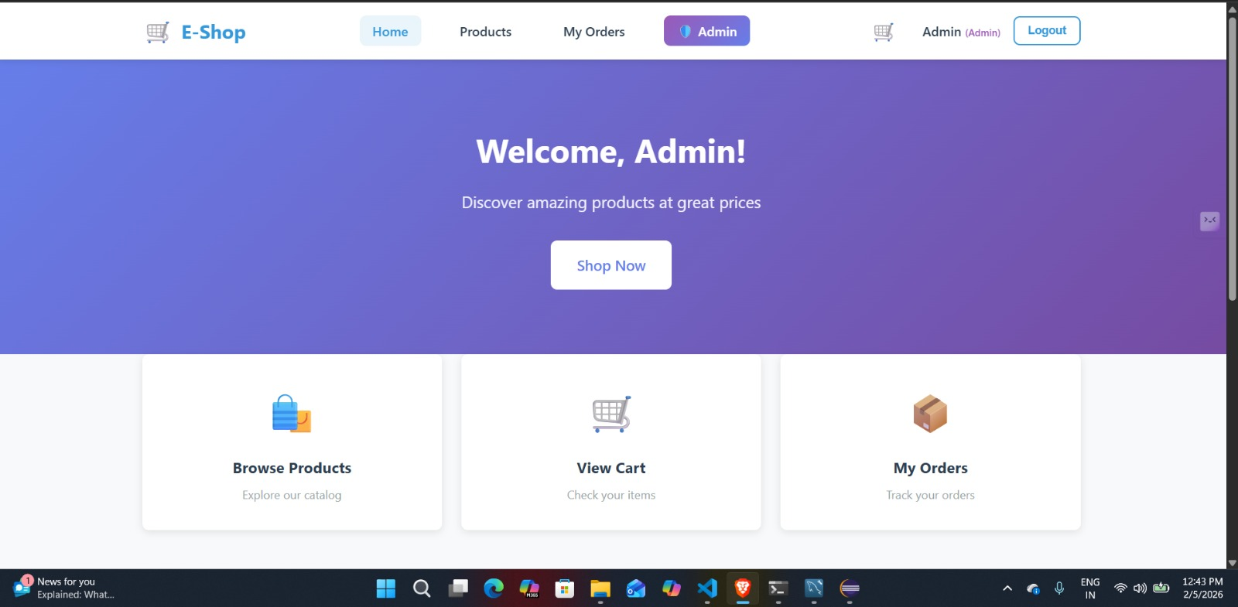
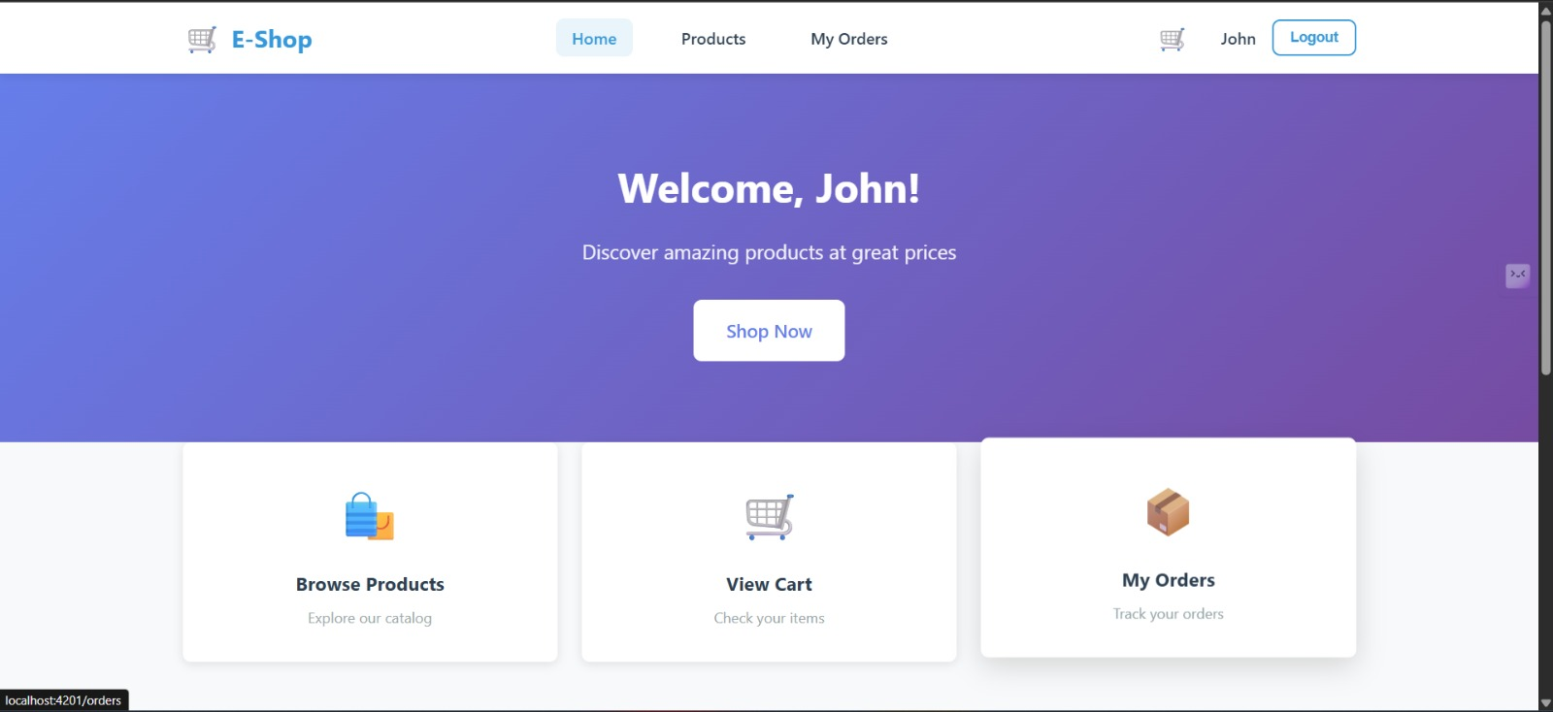

Project Overview
Objective: A full-stack web application designed to manage the end-to-end lifecycle of an e-commerce order, from user registration and product browsing to secure checkout and admin order tracking.
Key Goal: Implementing a scalable architecture using the Spring ecosystem and Angular framework.
2024 - RPS Consulting all rights reserved

Slide 3
Technology Stack
Tools Used to Build the System
Frontend: Angular 17+ (TypeScript, HTML/CSS, RxJS)
Backend: Spring Boot 3 (Java), Spring Data JPA, Spring Security
Database: MySQL 8.0
Tools: Maven, Lombok, VS Code/Eclipse
2024 - RPS Consulting all rights reserved

Slide 4
System Architecture
Presentation Layer: Angular UI communicating via REST APIs
Business Logic Layer: Spring Boot services handling orders, payments, and authentication
Data Access Layer: Hibernate/JPA mapping Java objects to MySQL tables
Connection: CORS configuration allowing port 4200 to talk to port 8080
2024 - RPS Consulting all rights reserved

Slide 5
Backend Deep Dive – Data Persistence
Storing and Managing Application Data
Entity Mapping: Classes like OrderItem.java and Payment.java map to database tables
Hibernate DDL-Auto: Using 'update' to sync Java entities with MySQL tables
Precision: BigDecimal used for financial accuracy in prices and subtotals
2024 - RPS Consulting all rights reserved

Slide 6
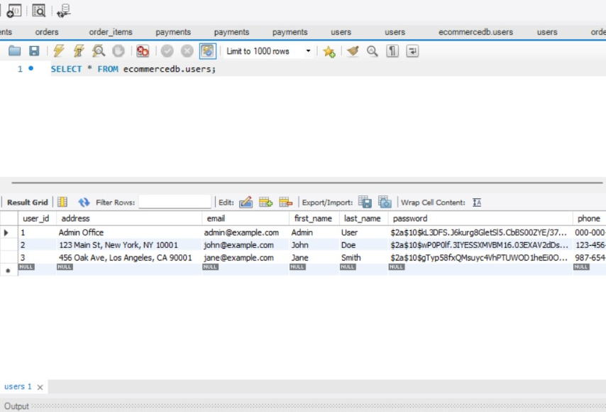
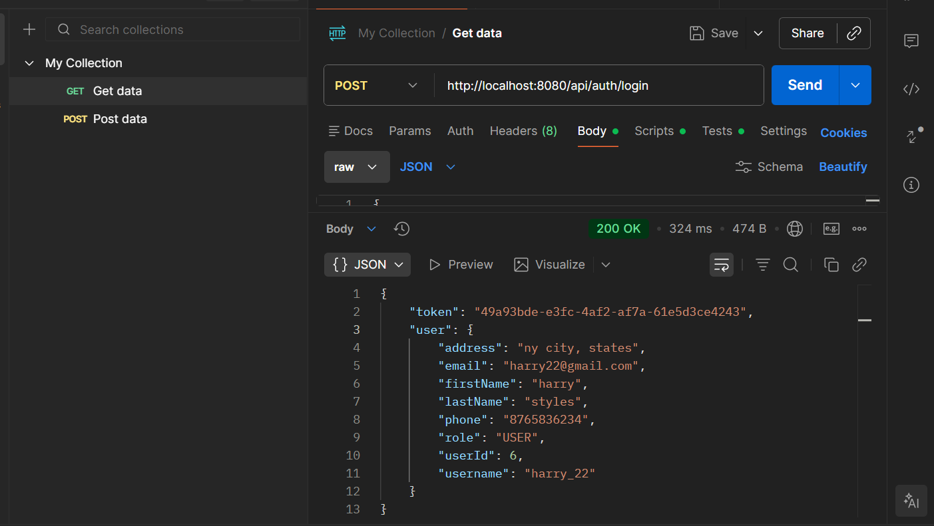
Backend Deep Dive – DTO Pattern
Separating Data Between Layers
What is DTO?: Data Transfer Objects like AuthResponse and OrderDto decouple the database from the UI
Security: Prevents sensitive information (like hashed passwords) from being sent to the frontend
We implemented password security using BCrypt hashing from the Spring Security library, ensuring that user passwords are never stored in plain text and are securely encrypted before being saved in the database
2024 - RPS Consulting all rights reserved

Slide 7
Frontend Deep Dive – Component Logic
Handling UI and User Interactions
Modular Design: Components for Registration, Login, Product List, and Order History
Service Layer: Angular Services (HttpClient) consume Spring Boot REST endpoints
State Management: LocalStorage or Auth Services track logged-in users
2024 - RPS Consulting all rights reserved

Slide 8
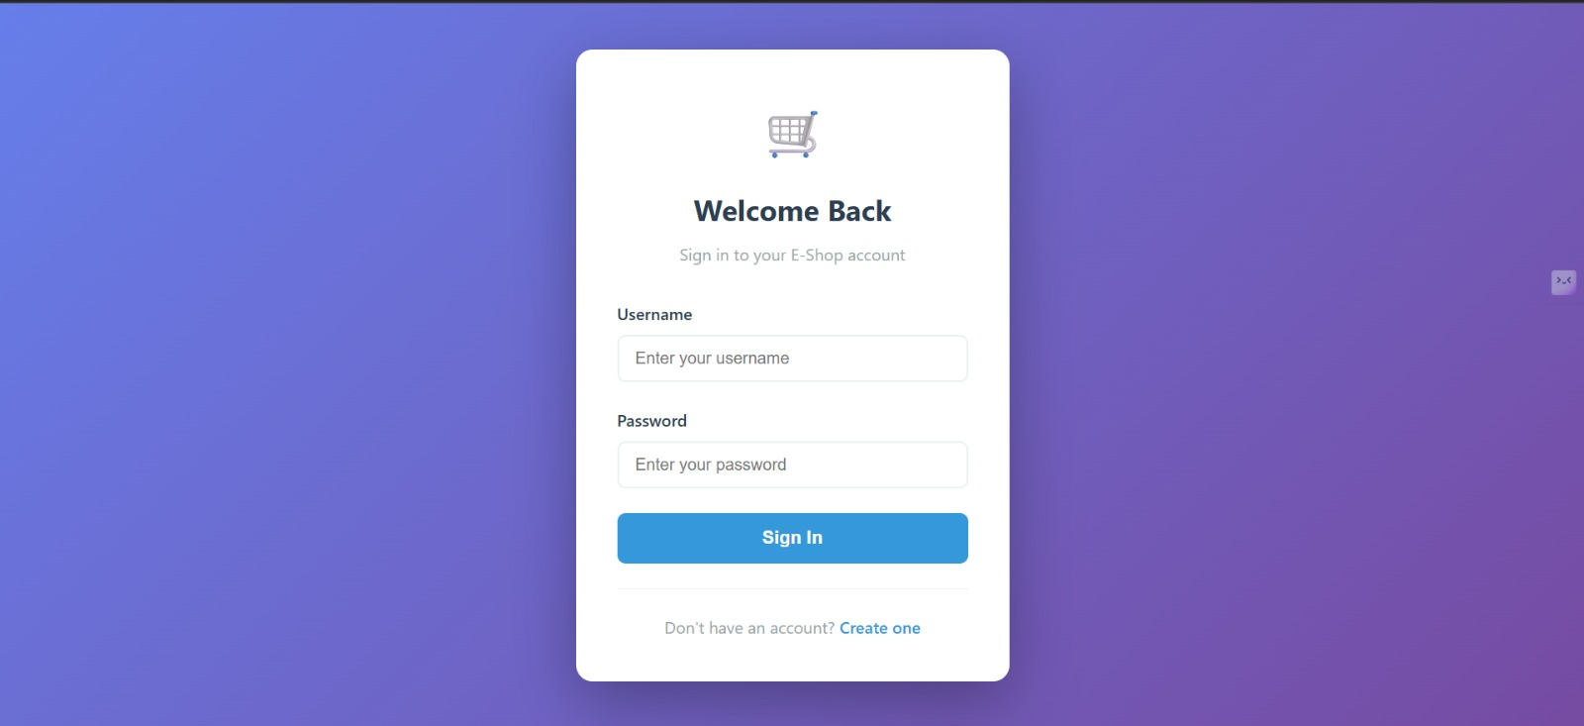
User Flow – Registration & Authentication
Secure User Access and Login Flow
Flow: Guest → Registration (/register) → Login (/login) → Authenticated User
Validation: Frontend form validation for emails and passwords
Security: Backend verification of credentials against the users table in MySQL
2024 - RPS Consulting all rights reserved

Slide 9
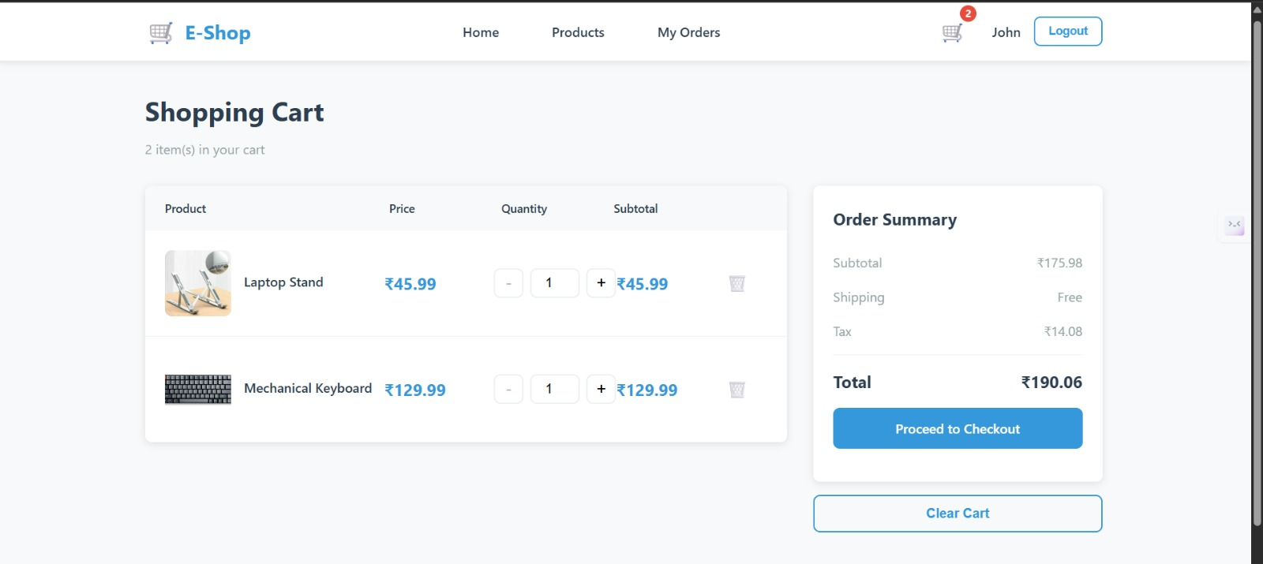
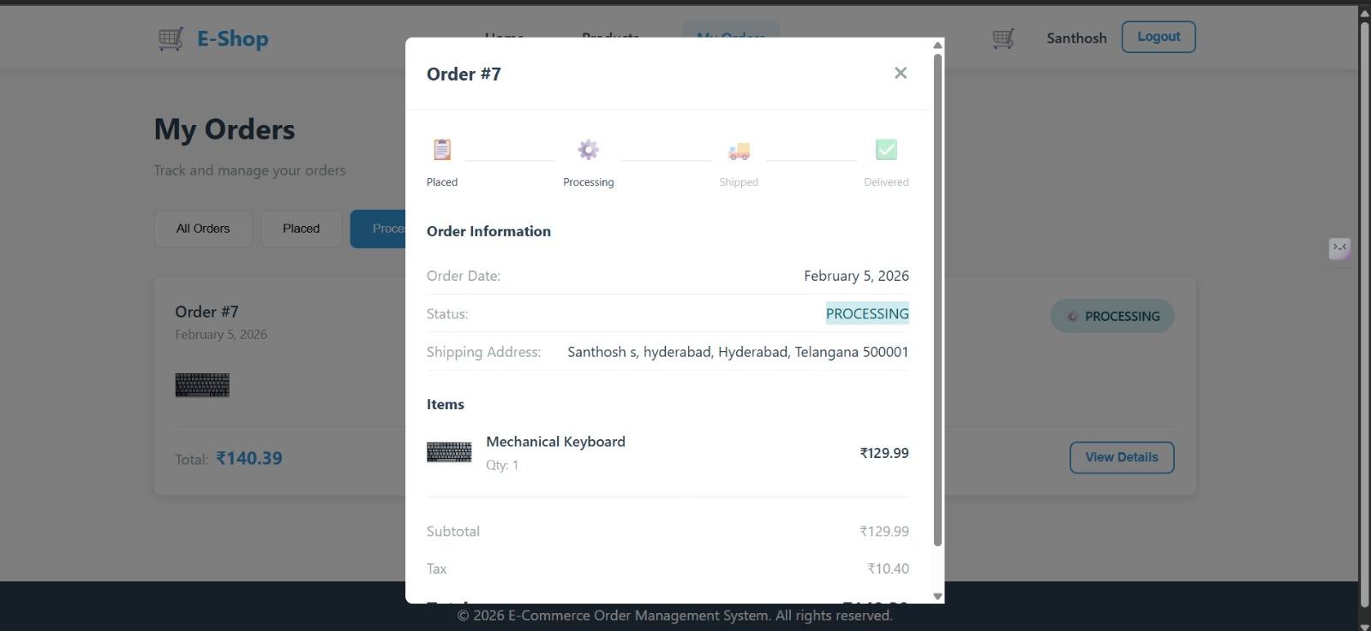
Core Feature – Order Lifecycle
Tracking Orders from Placement to Delivery
Order Placement: User adds products (Laptop Stand, Mechanical Keyboard) to cart and checks out
Order Tracking: Status updates — PLACED → PROCESSING → SHIPPED → DELIVERED
Persistence: Every order status change is updated in the MySQL database
2024 - RPS Consulting all rights reserved

Slide 10
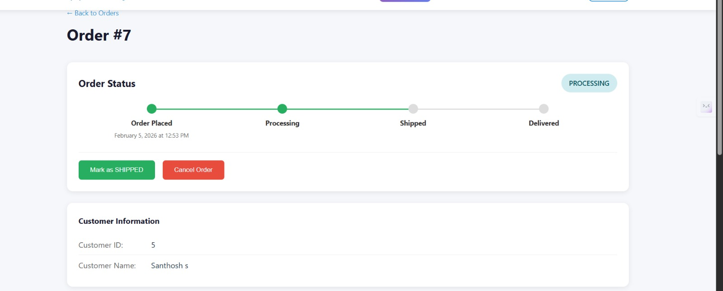
Admin Capabilities
Managing Orders and Users
Admin Dashboard: Special view for users with ROLE_ADMIN
Management: View all orders, change order statuses, cancel orders
Data Integrity: Admin actions are logged and reflected across the system
2024 - RPS Consulting all rights reserved

Slide 11
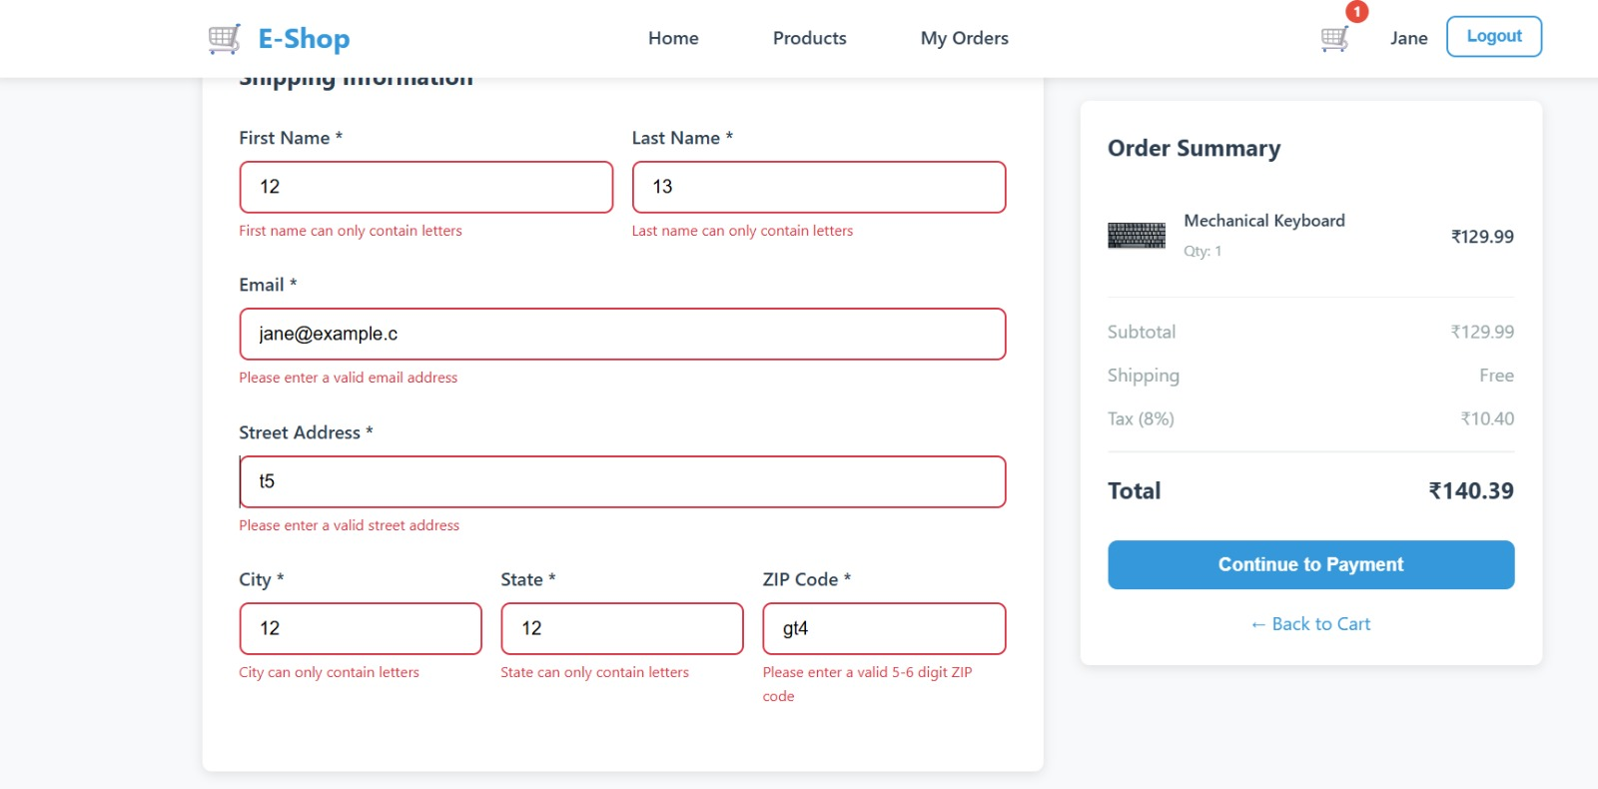
Validation
Ensuring Accurate User Input
The checkout form includes strong client-side validation to ensure accurate and secure data entry. Fields such as first name, last name, city, and state accept only alphabetic characters, while the email field is validated using proper email format rules. The street address requires meaningful input, and the ZIP code is restricted to valid 5–6 digit numeric values. Real-time validation messages guide users to correct errors immediately, improving data quality, user experience, and successful order processing
2024 - RPS Consulting all rights reserved

Slide 12
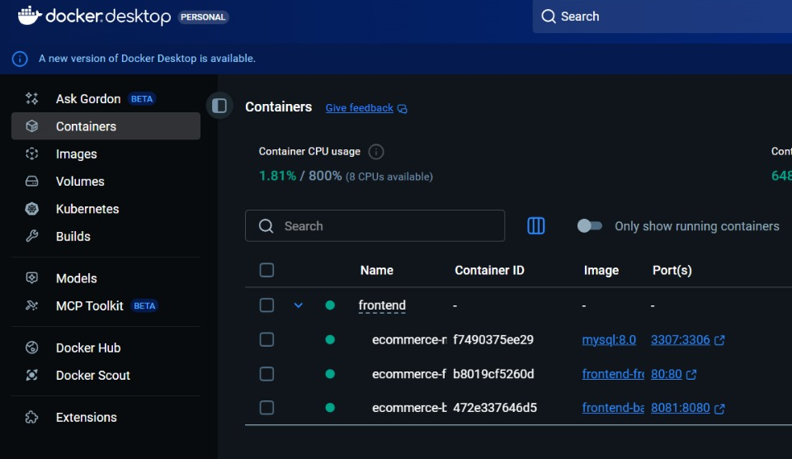
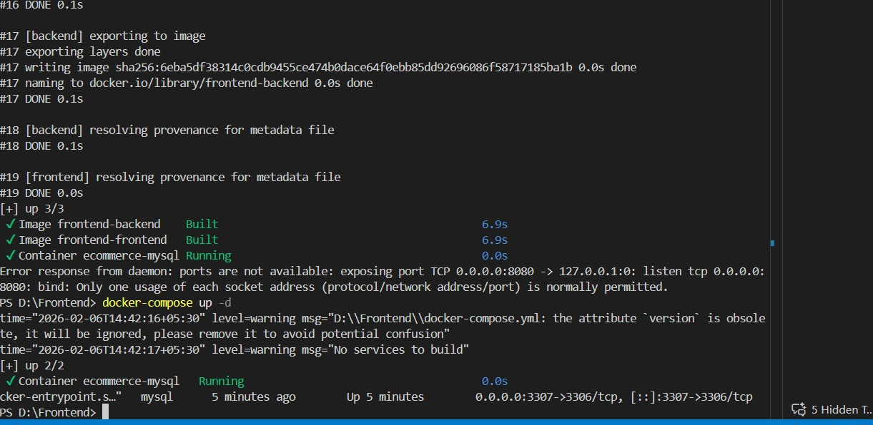
Deployment
Deployment Using Docker
The entire application was containerized using Docker to ensure consistency across development and deployment environments. Separate Docker images were created for the Angular frontend, Spring Boot backend, and MySQL database.
Using Docker Compose, all services were orchestrated and launched together with a single command, enabling seamless communication between containers through a shared network. This approach simplifies deployment, improves scalability, and ensures that the application runs reliably across different systems without environment-related issues.
2024 - RPS Consulting all rights reserved

Slide 13
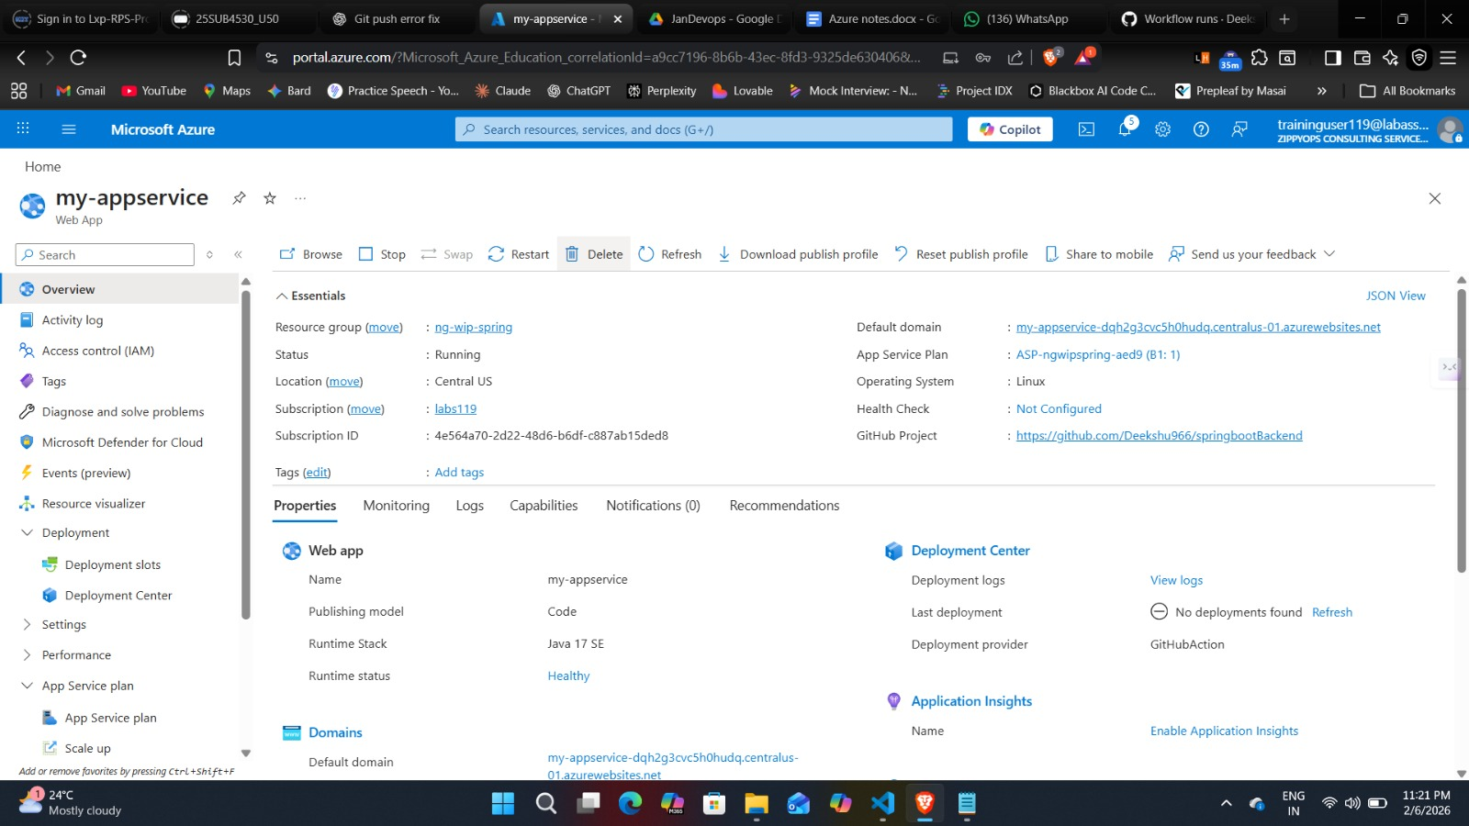
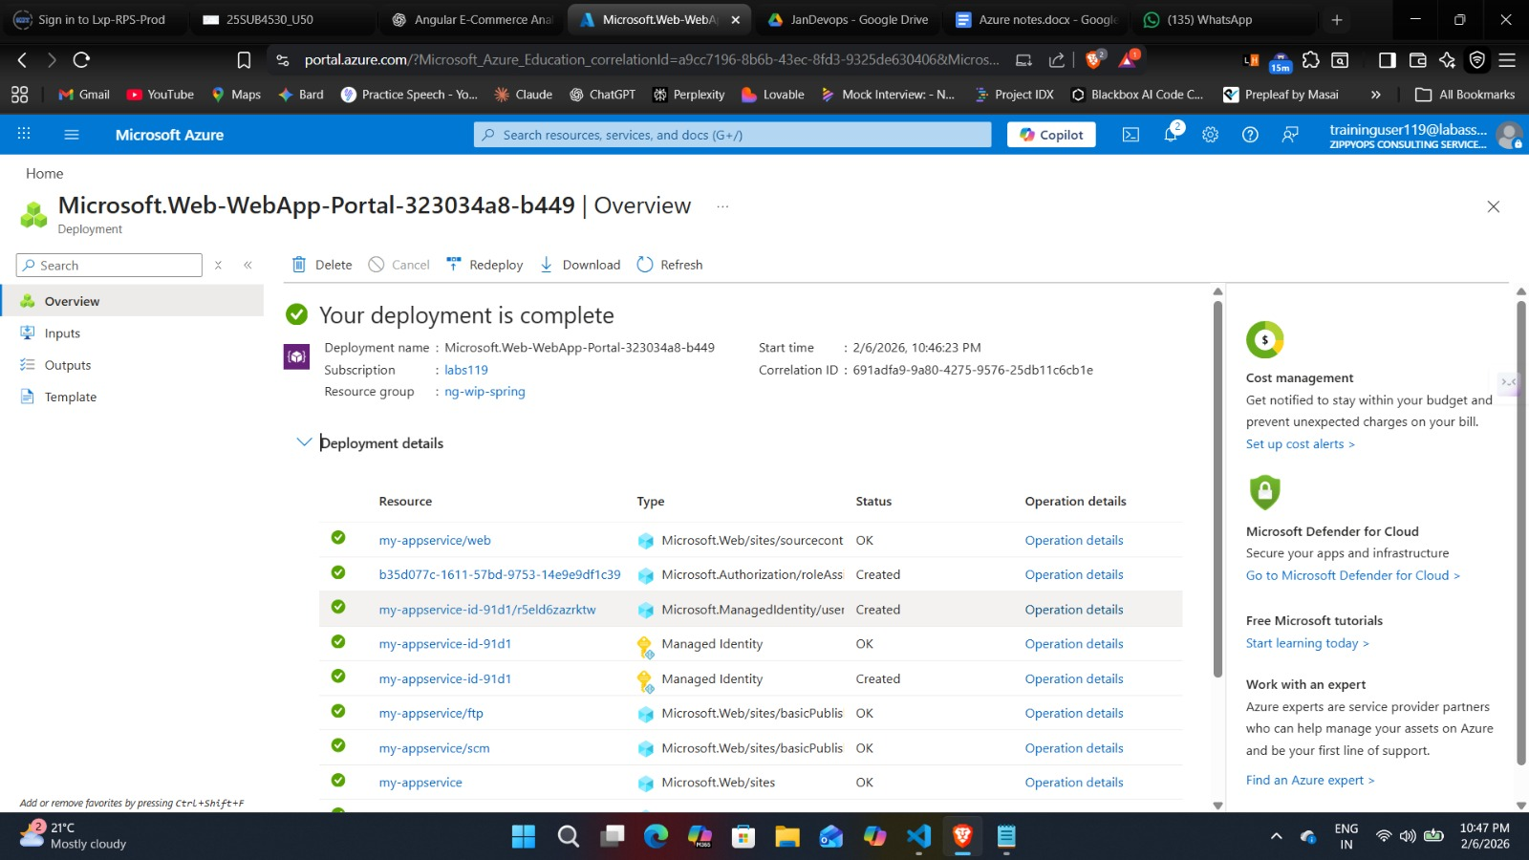
Deployment
Azure Deployment
The application was successfully deployed on Microsoft Azure using Azure App Service for the Spring Boot backend and cloud-based hosting for the frontend. The backend was connected to a managed MySQL database, ensuring secure and reliable data storage. Deployment was automated through GitHub integration, allowing continuous updates with every code push. Azure’s monitoring and deployment tools were used to verify application health, manage configurations, and ensure smooth production readiness. This deployment demonstrates real-world cloud hosting, scalability, and enterprise-level infrastructure management
2024 - RPS Consulting all rights reserved

Slide 14
Conclusion
The E-Commerce Order Management System successfully demonstrates the design and implementation of a secure, scalable, and fully functional full-stack web application. By integrating Angular for the frontend, Spring Boot for the backend, MySQL for data persistence, Docker for containerization, and Azure for cloud deployment, the project reflects real-world enterprise development practices. This project strengthened our understanding of full-stack architecture, security, cloud deployment, and system integration, making it a strong foundation for professional software development.
The system streamlines the entire order lifecycle through secure REST API integration and automated workflows. By reducing manual errors and providing reliable data tracking, it offers a scalable, efficient solution for modern digital businesses.
2024 - RPS Consulting all rights reserved

Slide 15
THANK YOU
2024 - RPS Consulting all rights reserved

